Slide 1
K-Nearest Neighbors (KNN)

Slide 2
Assumptions of KNN
Similar points exist in close proximity
Data is meaningful in distance space
All features contribute equally unless scaled

Slide 3
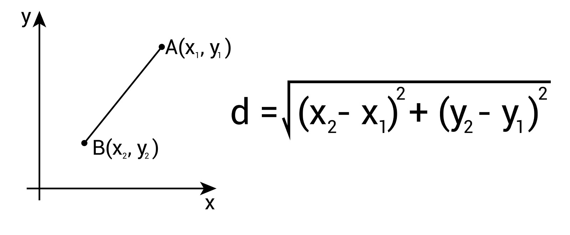
Euclidean Distance
Example:
Point A(2,3), Point B(5,7)
Distance = sqrt(9 + 16) = 5

Slide 4
Voting in KNN
Example:
K = 5 neighbors
Class labels: A, A, B, A, B
Majority = A
Predicted class = A

Slide 5
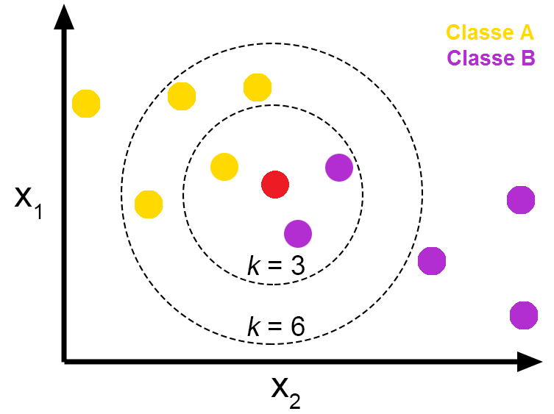
KNN Algorithm Steps
Given:
  Training Data (X - input variables, y - target),
  Test Data (only X, y - to find)
Choose value of K
Take 1st example of test data x₁
Calculate distance between test data x₁ and all training points
Sort distance and select K nearest neighbors
Perform voting (classification) or averaging (regression) of K nearest neighbors
Assign final output
Repeat process from step 4 to 7 for all test examples
Find accuracy

Slide 6
Other Distance Metrics
Manhattan Distance
Minkowski Distance
Cosine Similarity
Hamming Distance

Slide 7
Distance for Categorical Variables
Use Hamming distance
Encode categories (One-Hot Encoding)
Similarity = match (0) or mismatch (1)

Slide 8
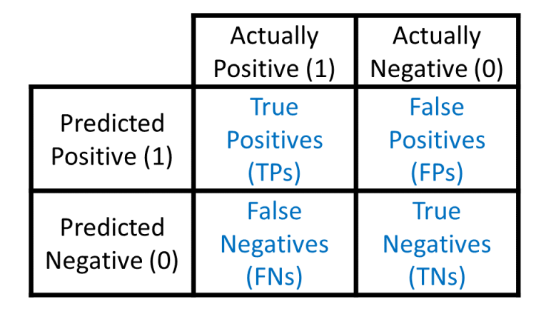
Confusion Matrix
Accuracy = (TP + TN) / (TP + TN + FP + FN)

Slide 9
Choosing Best K Value
Use loop with cross-validation
Try multiple K values
Select K with highest validation accuracy
Generally use odd values of K to avoid conflict
  E.g. 3,5,7,9,11 etc.

Slide 10
Advantages of KNN
Simple and intuitive
No training phase
Works well with small datasets

Slide 11
Disadvantages of KNN
Computationally expensive
Sensitive to noise
Requires feature scaling

Slide 12
Applications of KNN
Recommendation systems
Medical diagnosis
Pattern recognition
Credit scoring

Slide 13
Naive Bayes Algorithm for Classification

Slide 14
Introduction
Naïve Bayes is a probabilistic algorithm used for classification tasks, based on Bayes' Theorem and the assumption that features are conditionally independent given the class label.
It is widely used in spam filtering, text classification, sentiment analysis, and medical diagnosis due to its simplicity and efficiency

Slide 15
Assumptions
Conditional Independence of Features
Equal Importance of Features
Presence of All Classes in Training Data
Categorical (frequency-based probability) or Normally Distributed (continuous data) Features

Slide 16
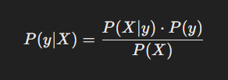
Understanding Bayes’ Theorem
where,
P(y∣X) = Probability of class y given the feature set X (Posterior Probability)
P(X∣y) = Probability of feature set X given class y (Likelihood)
P(y) = Prior probability of class y
P(X) = Probability of feature set X (Evidence)
Aim:
For classification, the goal is to determine the class y that maximizes P(y∣X)

Slide 17
id | Age (Years) | Income (K$) | Gender | Purchase (Y/N)
1 | 25 | 50 | Male | Yes
2 | 45 | 80 | Female | No
3 | 35 | 60 | Male | Yes
4 | 50 | 90 | Female | No
5 | 23 | 40 | Female | Yes
6 | 40 | 70 | Male | No

Slide 18

Assumption of Feature Independence
Naïve Bayes assumes that each feature in X is independent given the class label y, so the likelihood can be rewritten as:
P(A / B) = P(A) * P(B), A & B are independent

Slide 19

Compute Prior Probabilities
Example
P(Yes) = Count of Yes / total samples = 3 / 6 = 0.5
P(No) = Count of No / total samples = 3 / 6 = 0.5
For each class y_{i}, calculate:

Slide 20
Compute Likelihood P(X∣y)
For categorical : Using frequency count:
P(Male/Yes) = Count of Males in Yes / Total Count of Yes = 2 / 3 = 0.67
P(Male/No) = Count of Males in No / Total Count of No = 1 / 3 = 0.33
P(Female/Yes) = Count of Females in Yes / Total Count of Yes = 1 / 3 = 0.33
P(Female/No) = Count of Females in No / Total Count of No = 2 / 3 = 0.67

Slide 21

Compute Likelihood P(X∣y)
Age
Class | Mean (μ\mu) | Std Dev (σ\sigma)
Yes | 27.67 | 6.036
No | 45 | 5
For Continuous Variables (Gaussian Distribution)
Income
Class | Mean (μ\mu) | Std Dev (σ\sigma)
Yes | 50 | 8.16
No | 80 | 8.16

Slide 22
Compute Posterior
For Continuous data: Gaussian Distribution
Age:
P(25/Yes) = 1 / (√ 2 * 𝛑 * 6.03²) * exp( - (25-27.67)² / (2*6.03²) ) = 0.060
P(25/No) = 1 / (√ 2 * 𝛑 * 5²) * exp( - (25-45)² / (2*5²) ) = 0.0000268

Slide 23
Compute Posterior for New Data
Age | Income | Gender
30 | 55 | Male
Yes
Age :
P(30/Yes) = 1 /(√ 2 * 𝛑 * 6.03²)* exp(-(30-27.67)² /(2*6.03²))= 0.06
Income:
P(55/Yes) = 1 / (√ 2 * 𝛑 * 8.16²) * exp( - (55-50)² /(2*8.16²)) = 0.045
Gender:
P(Male/Yes)=0.67
No
Age:
P(30/No) = 1 / (√ 2 * 𝛑 * 5²) * exp( - (30-45)² / (2*5²) ) = 0.003
Income:
P(55/No) = 1 / (√ 2 * 𝛑 * 8.16²) * exp( - (55-80)² / (2*8.16²)) = 0.002
Gender:
P(Male/No)=0.33

Slide 24
Compute Posterior Probabilities
P(Yes∣X) ∝ P(Yes) * P(30∣Yes) * P(55∣Yes) * P(Male∣Yes)
∝ 0.5 * 0.06 * 0.045 * 0.67
∝ 0.009
P(No∣X) ∝ P(No) * P(30∣No) * P(55∣No) * P(Male∣No)
∝ 0.5 * 0.003 * 0.002 * 0.33
∝ 0.000001
Normalize Probabilities
P(Yes∣X) = 0.009 / (0.009 + 0.000001) = 0.999
P(No∣X) = 0.000001 / (0.009 + 0.000001) = 0.001
Since P(Yes∣X) is much higher, the final prediction would be "Yes" (Purchase). ​​

Slide 25
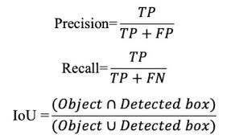
Performance Measure
Precision : Of all the items the model predicted as positive, how many were actually positive?
Recall : Of all the actual positive items, how many did the model correctly identify?
Notes:
High precision → When the model predicts positive, it is usually correct.
High recall → The model finds most of the positive cases

Slide 26
Advantage
Simple and fast.
Works well with text data (spam filtering, sentiment analysis).
Handles missing values using smoothing.

Slide 27
Disadvantages
Assumes independence between features (not always true).
If feature probabilities are zero, it can cause issues (solved by Laplace smoothing).

Slide 28
Common Applications:
Email spam detection
Sentiment analysis
Medical diagnosis

Slide 29
Cross Validation

Slide 30
What is Cross Validation & Why it is needed
Cross-validation is used in Machine Learning to check how well a model will work on new, unseen data, not just on the data it was trained on.
Why it is needed If a model is tested only on training data:
It may memorize the data (overfitting)
It may look accurate but fail on real-world data
Cross-validation helps avoid this.

Slide 31
Types of Cross Validation (CV)
Hold-Out Validation (Train–Test Split)
K-Fold CV
Stratified K-Fold CV
Leave-One-Out CV(LOOCV)
Time Series CV

Slide 32
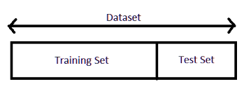
Hold-Out Validation (Train–Test Split)
What it is:
Data is split once into training and testing sets (e.g., 80%–20%).
Best for:
  Large datasets
  Quick baseline checks
Limitation:
  Result depends heavily on one random split

Slide 33

K-Fold CV
What it is:
  Data is divided into K equal parts (folds)
  Train on K-1 folds, test on 1 fold
  Repeat K times, average the result
Best for:
  Small to medium datasets
  General-purpose model evaluation

Slide 34
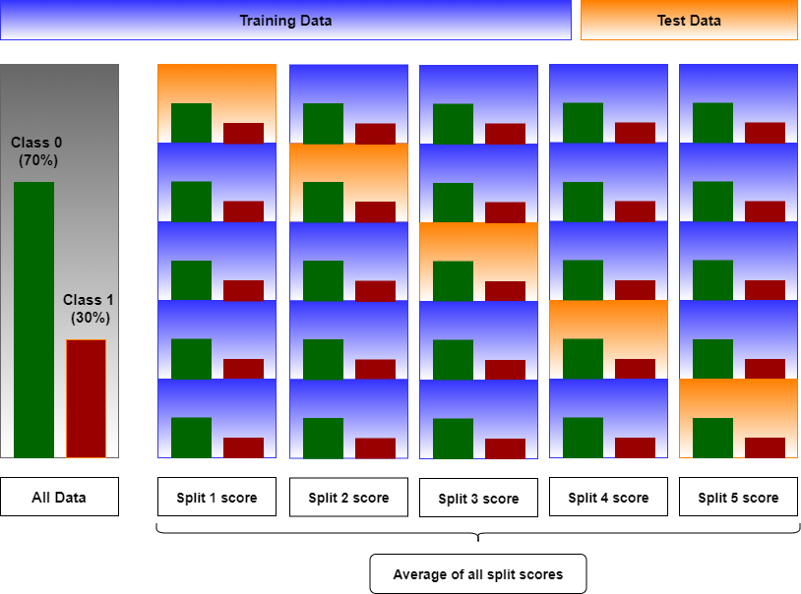
Stratified K-Fold CV
What it is:
Same as K-Fold, but class proportions are preserved in each fold.
Best for:
  Imbalanced classification problems
  Binary or multi-class classification
Example:
If 90% data is class A, each fold keeps ~90% A.

Slide 35
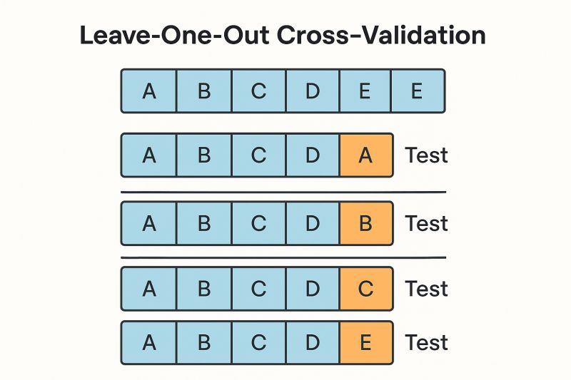
Leave-One-Out CV(LOOCV)
What it is:
  Train on N-1 samples
  Test on 1 sample
  Repeat for every data point
Best for:
  Very small datasets
Limitation:
  Computationally expensive
  High variance

Slide 36
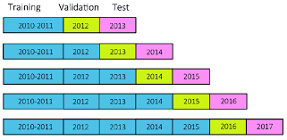
Time Series CV
What it is:
Respects time order:
  Train on past data
  Test on future data
Best for:
  Forecasting
  Any time-dependent data
Important rule:
  Never shuffle time series data

Slide 37
Decision Tree

Slide 38
Assumptions
Samples Are Independent and Identically Distributed (i.i.d.)
Feature Scale Does Not Matter

Slide 39
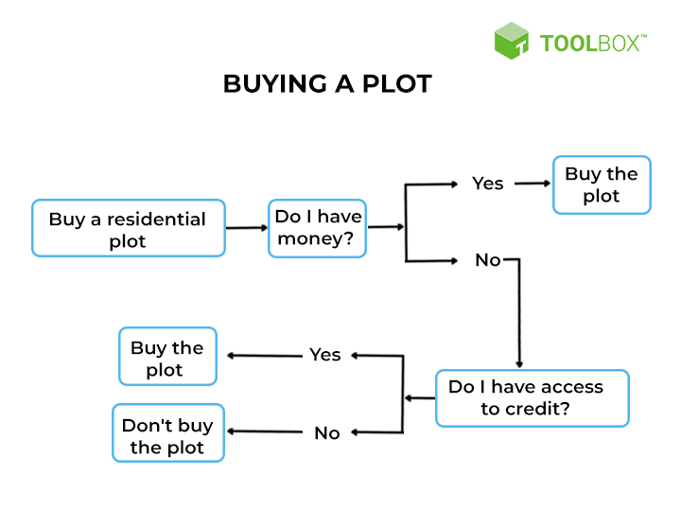
Decision Tree
Rule based algorithm
Iteratively find split points for decisions
Each node has two children and one parent
Intuitive
Simple to implement
Image source: What Is a Decision Tree? Algorithms, Template, Examples, and Best Practices

Slide 40
Decision Tree
Example: A small drug molecule for headache with three descriptors. Find out whether the drug molecule is active or inactive against headaches.
Intermediate nodes
Root node
ID | Descriptor 1 | Descriptor 2 | Descriptor 3 | Active/ Inactive
1 | 3 | 14113 | 28 | 1
2 | 5 | 1216 | 58 | 1
3 | 6 | 3234 | 63 | 1
4 | 5 | 1198 | 55 | 1
5 | 4 | 10974 | 26 | 1
6 | 2 | 1300 | 45 | 0
7 | 2 | 1068 | 38 | 0
8 | 1 | 672 | 54 | 0
9 | 2 | 1934 | 36 | 0
10 | 2 | 6260 | 30 | 0
D2
< 4076
Y
N
D1
< 4
N
1
Y
D3
<= 48
Leaf nodes
0
Y
N
0
1
Model: Decision Tree

Slide 41
Which attribute to use to split and split point
Take first feature -> discretise the values -> pick a split point -> calculate impurity/add info using example at the split point
Repeat this for every split point for all features
Select the feature-split pair with least impurity or most add info -> decision node
Repeat these steps till you reach a point where each node has example for only one class or up to pre-defined depth
2
3.5
5
D1 min
D1 max
D1
< 2
N
Y

Slide 42
Multiple Decision Tree
Base on different splitting criteria, there could be more than one tree that fits the same data.
D2
< 7897
ID | Descriptor 1 | Descriptor 2 | Descriptor 3 | Active/ Inactive
1 | 3 | 14113 | 28 | 1
2 | 5 | 1216 | 58 | 1
3 | 6 | 3234 | 63 | 1
4 | 5 | 1198 | 55 | 1
5 | 4 | 10974 | 26 | 1
6 | 2 | 1300 | 45 | 0
7 | 2 | 1068 | 38 | 0
8 | 1 | 672 | 54 | 0
9 | 2 | 1934 | 36 | 0
10 | 2 | 6260 | 30 | 0
Y
N
D1
< 3
1
N
Y
D3 >= 30
1
Y
N
1
0

Slide 43
Decision Tree to Rules
Decision tree can be converted to set of rules.
Our example DT gives total of 4 rules :
D2 >= 4076, then the drug is active.
D2 < 4076 AND D1 < 4, then the drug is inactive.
D2 < 4076, D1 >=4 AND D3 > 48, then the drug is active.
D2 < 4076, D1 >=4 AND D3 <= 48, then the drug is inactive.
D2
< 4076
Y
N
D1
< 4
N
1
Y
D3
<= 48
0
Y
N
0
1

Slide 44
Splitting Criteria
Decided based on following measures at each split:
Impurity
  Gini index
Added information
  Information Gain

Slide 45
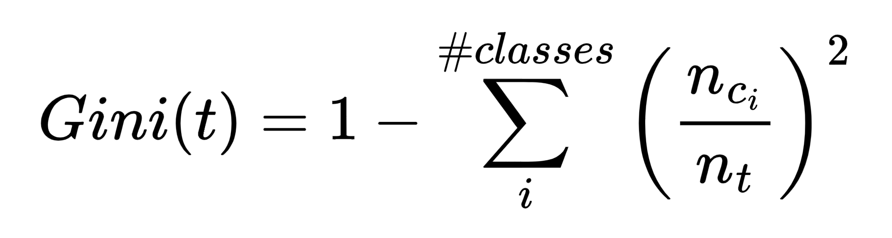
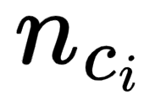
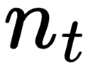
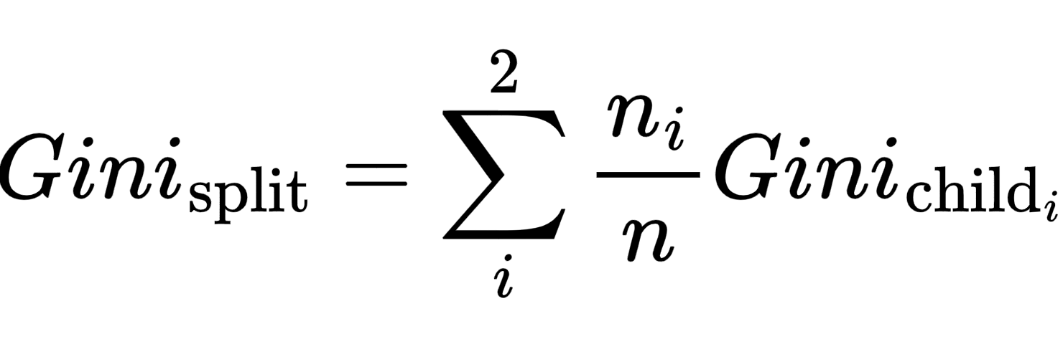
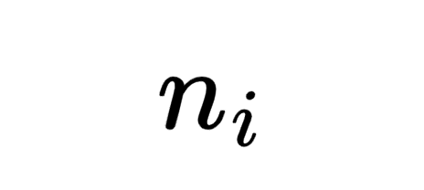
Gini Index
Gini Index for a child node, t
where,
= number of examples at node t belonging to class i.
= total number of examples at node t.
Gini Index for a split
where,
= number of examples at node t belonging to class i.
= total number of examples at node t.

Slide 46
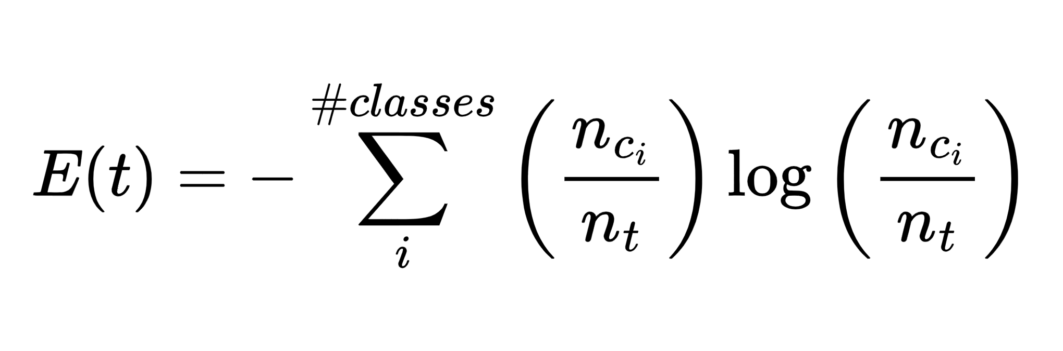
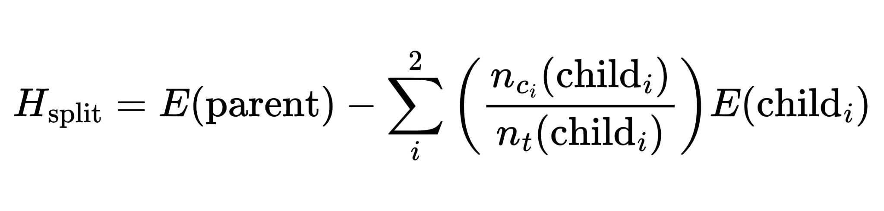
Information Gain
Entropy of a node, t
where,
= number of examples at node t belonging to class i.
= total number of examples at node t.
Information gain for a split

Slide 47
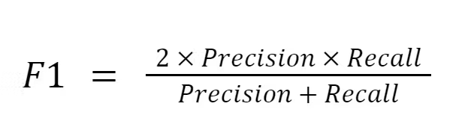
Performance Measure
F1-Score : Harmonic mean of Precision & Recall.
Notes:
High precision → When the model predicts positive, it is usually correct.
High recall → The model finds most of the positive cases

Slide 48
Advantage
Easy to Understand & Interpret
No Feature Scaling Required
Handles Non linear data

Slide 49
Disadvantages
Prone to overfitting
High Variance
Unstable with noisy data

Slide 50
Common Applications:
Medical diagnosis
Credit approval
Sales forecasting
Customer churn predictions

Slide 51
Bias Variance Trade-off

Slide 52
Prediction Error in ML
When a model makes wrong predictions, it creates error.
Total error comes from different sources.
Two main sources are Bias and Variance.

Slide 53
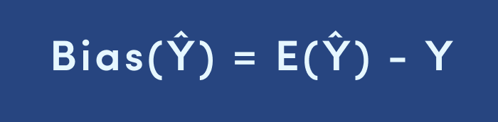
What is Bias?
Bias happens when a model is too simple.
It makes strong assumptions about data.
High bias models underfit the data.
Examples
Using a straight line for complex data.
Model ignores important patterns.
Training and test accuracy both are low.

Slide 54
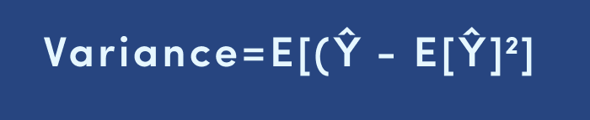
What is Variance?
Variance happens when a model is too complex.
It learns noise from training data.
High variance models overfit the data.
Example
Very deep decision tree.
Excellent training accuracy.
Poor performance on new data.

Slide 55
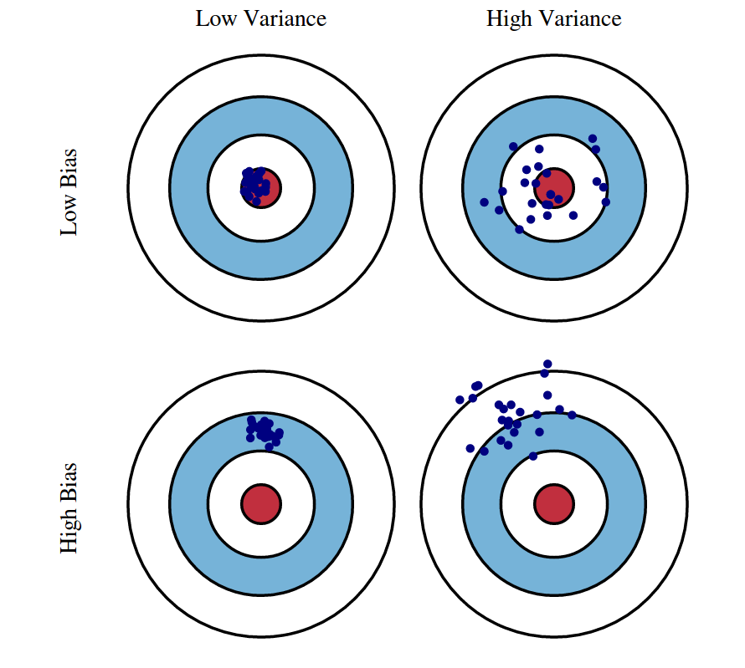
Bias vs Variance
High Bias → Underfitting.
High Variance → Overfitting.
Both reduce model performance.

Slide 56
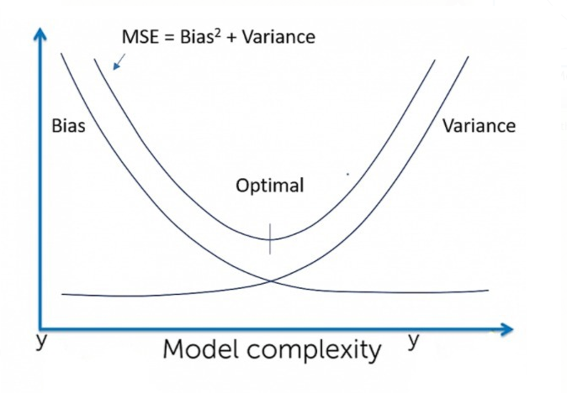
Bias–Variance Trade-off
Reducing bias increases variance.
Reducing variance increases bias.
Goal is to balance both.

Slide 57
Model Complexity Effect
Simple model → High Bias, Low Variance.
Complex model → Low Bias, High Variance.
Best model lies in between.

Slide 58
How to Reduce Bias
Use more complex models.
Add more features.
Reduce regularization.

Slide 59
How to Reduce Variance
Use more training data.
Apply regularization.
Use ensemble methods like Bagging.

Slide 60
Summary
Bias and variance cause prediction errors.
Simple models → Bias problem.
Complex models → Variance problem.
Balanced model gives best performance.

Slide 61
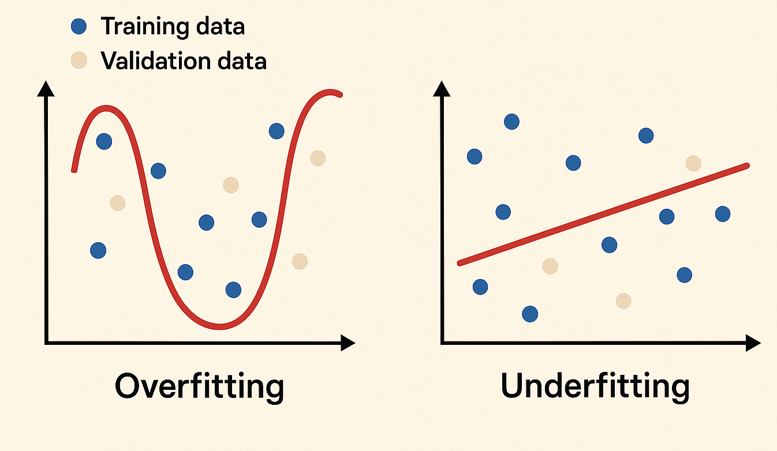
What is Underfitting?
Model is too simple to capture patterns.
High bias, low variance.
Poor performance on training and test data.
Example
Using a straight line for curved data.
Low training accuracy.
Low test accuracy.

Slide 62
What is Overfitting?
Model is too complex.
Learns noise from training data.
High variance, low bias.
Example
Very deep decision tree.
Very high training accuracy.
Poor test accuracy.

Slide 63
How to Fix Underfitting
Use more complex model.
Add more features.
Reduce regularization.

Slide 64
How to Fix Overfitting
Use more data.
Apply regularization.
Use ensemble methods like Bagging.

Slide 65
Bagging

Slide 66
What is an ensemble
An ensemble means using a group instead of a single one to make a decision.
Instead of trusting one model, we trust many models together.
“Ensemble learning is a technique where multiple models are combined to make a final prediction that is better than any single model.”

Slide 67
What is Bagging?
Bagging stands for Bootstrap Aggregating.
It is an ensemble learning technique.
Multiple models are trained instead of one.

Slide 68
Why Do We Use Bagging?
Single models can overfit the data.
Bagging reduces overfitting.
It improves accuracy and stability.

Slide 69
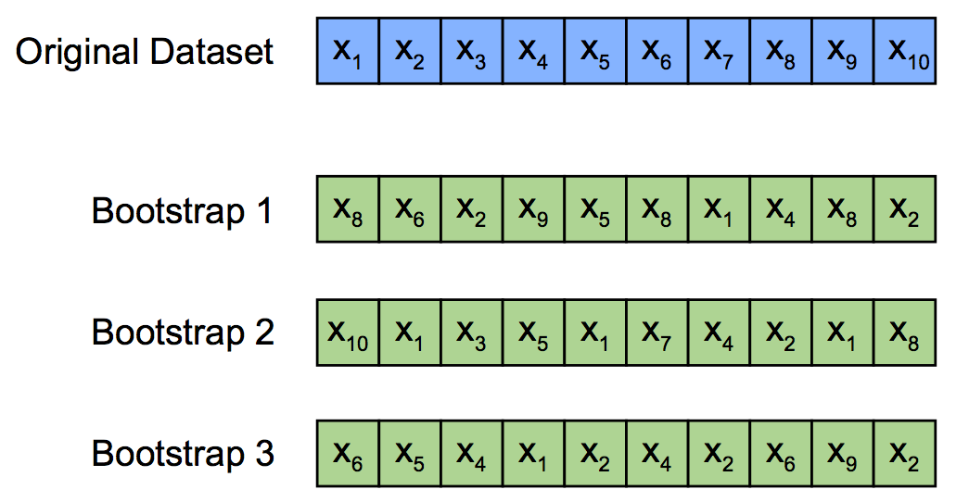
Bootstrap Sampling
Random samples are created with replacement.
Same data point can appear multiple times.
Each model sees slightly different data.

Slide 70
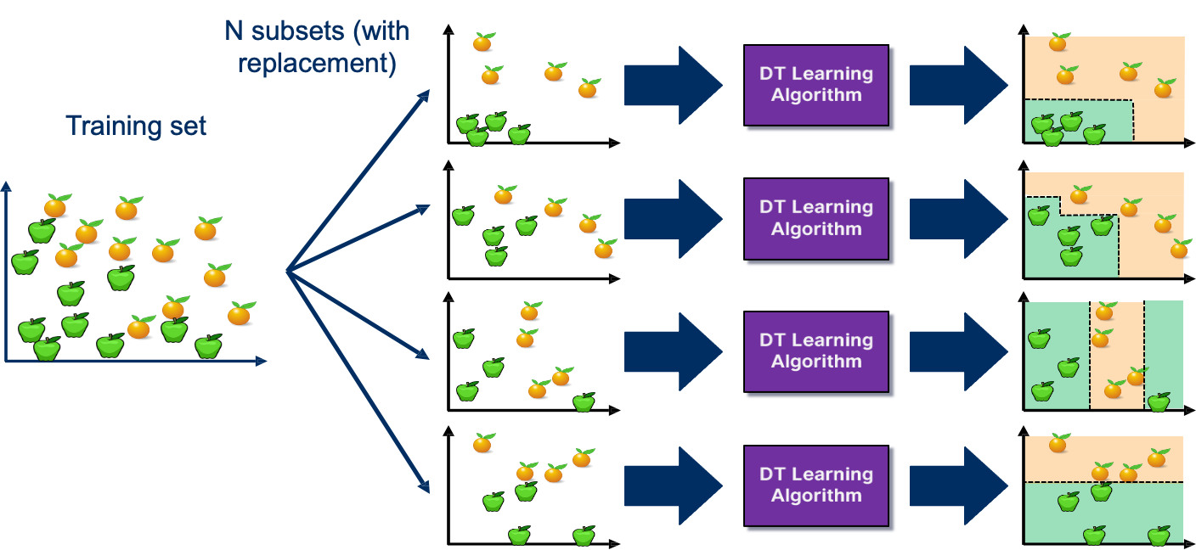
Bagging (training)
Create multiple random samples from training data.
Train a separate model on each sample.
Get Final Prediction by Voting

Slide 71
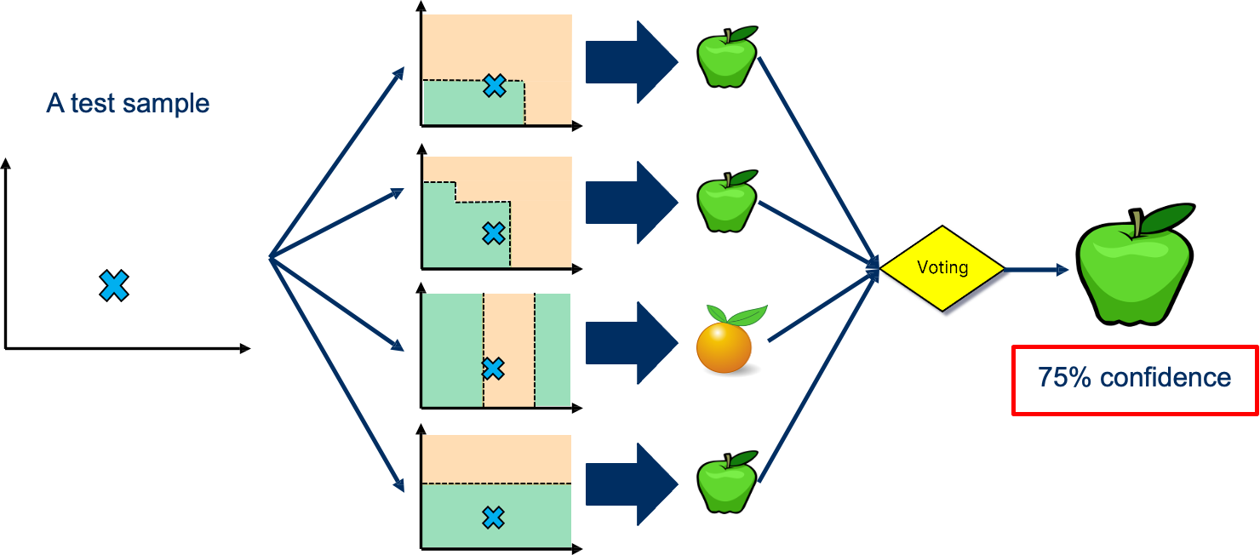
Bagging (inference)

Slide 72
Prediction in Classification
Each model gives a class prediction.
Final output is decided by majority voting.
Class with maximum votes is selected.
Example
Suppose we train 5 decision trees.
Predictions: Yes, Yes, No, Yes, No.
Final prediction: Yes (majority vote).

Slide 73
Advantages of Bagging
Reduces overfitting.
Works well with high variance models.
Improves prediction accuracy.

Slide 74
Limitations of Bagging
Less improvement for low-variance models.
Increases computation cost.
Model interpretability is reduced.

